Slide 1
Team Thunder Soldiers!
Akshay Newgi
Jenny Cheng
Shannon Li
Sonny Desai
Wei Sui

Slide 2
Motivation & Summary
One of our clients, a wealthy investor, would like to open a new restaurant in Orange County, and has narrowed the potential location down to 10 of the County’s most populous cities.
Our client wants to know the following: which city they can charge the highest price in, how long they should stay open to maximize customer ratings, and which type of cuisine they should serve based on the most popular customer ratings.
To do that, we must figure out the most profitable location of the 10 cities selected; how long to keep the restaurant running for, and last but not least, what cuisine to specialize in to attract the most customers.
Cities vs Price Point:
Business question: Which city, of the chosen 10, has the highest price point for popular restaurants?
2. Hours of Operation vs Customer Rating
Business question: How many hours of operation should you open your restaurant for?
3. Cuisine vs Customer Rating
Business question: What’s the most popular restaurant cuisine in these OC cities?

Slide 3
Questions & Data
1) Business question: Which city, of the chosen 10, has the highest price point for popular restaurants?
We wanted to determine which city had the most popular restaurants and were also charging the most money. We chose 10 of the most populous city from Orange County and their 100 most popular restaurants. Next, we discovered their price point based on the yelp valuation and sorted them in categories. From there we found the averages of the popular restaurants and their price points per city. We found the data using the Yelp API.
2) Business question: How many hours of operation should you open your restaurant for?
We wanted to determine the ideal time to keep a restaurant open for while maintaining the highest possible ratings. From the restaurants we chose in the last question, we got total hours of operation of the restaurants for the week, and their yelp rating from the Yelp API. Then, we sorted the restaurants into categories based on yelp rating and found the average rating per total operation hours
3) Business question: What’s the most popular restaurant cuisine in these OC cities?
We wanted to determine which restaurant cuisine our client should open. We determined this by pulling data of the top 100 restaurants per the cities we chose, along with their ratings. From there, we sorted the restaurants into categories by cuisine and determined which cuisine type had the highest average rating.

Slide 4
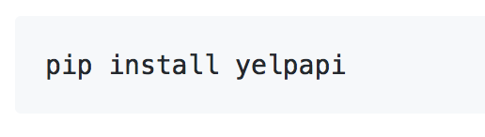
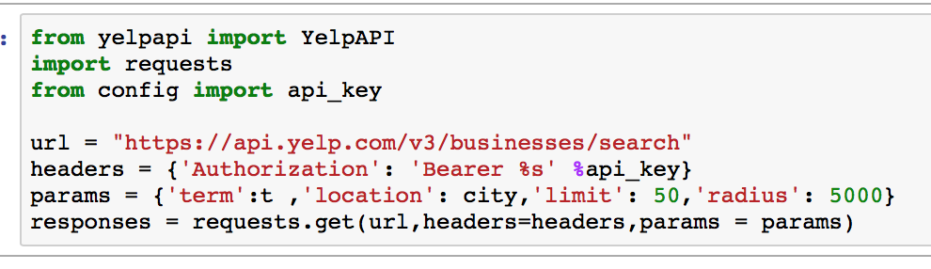

How to pull Data from Yelp Fusion API?
Set Environment:
Pulling Data:

Slide 5


Data Scoping and Data Limitations
Cities
Cuisine Types
Limitations
The Yelp API can only return up to 1,000 results at this time. The API does not allow more than 50 results per request.
Therefore, we chose to analyze data for the top 100 restaurants in the 10 most populous cities in Orange County, instead of the entire County.

Slide 6
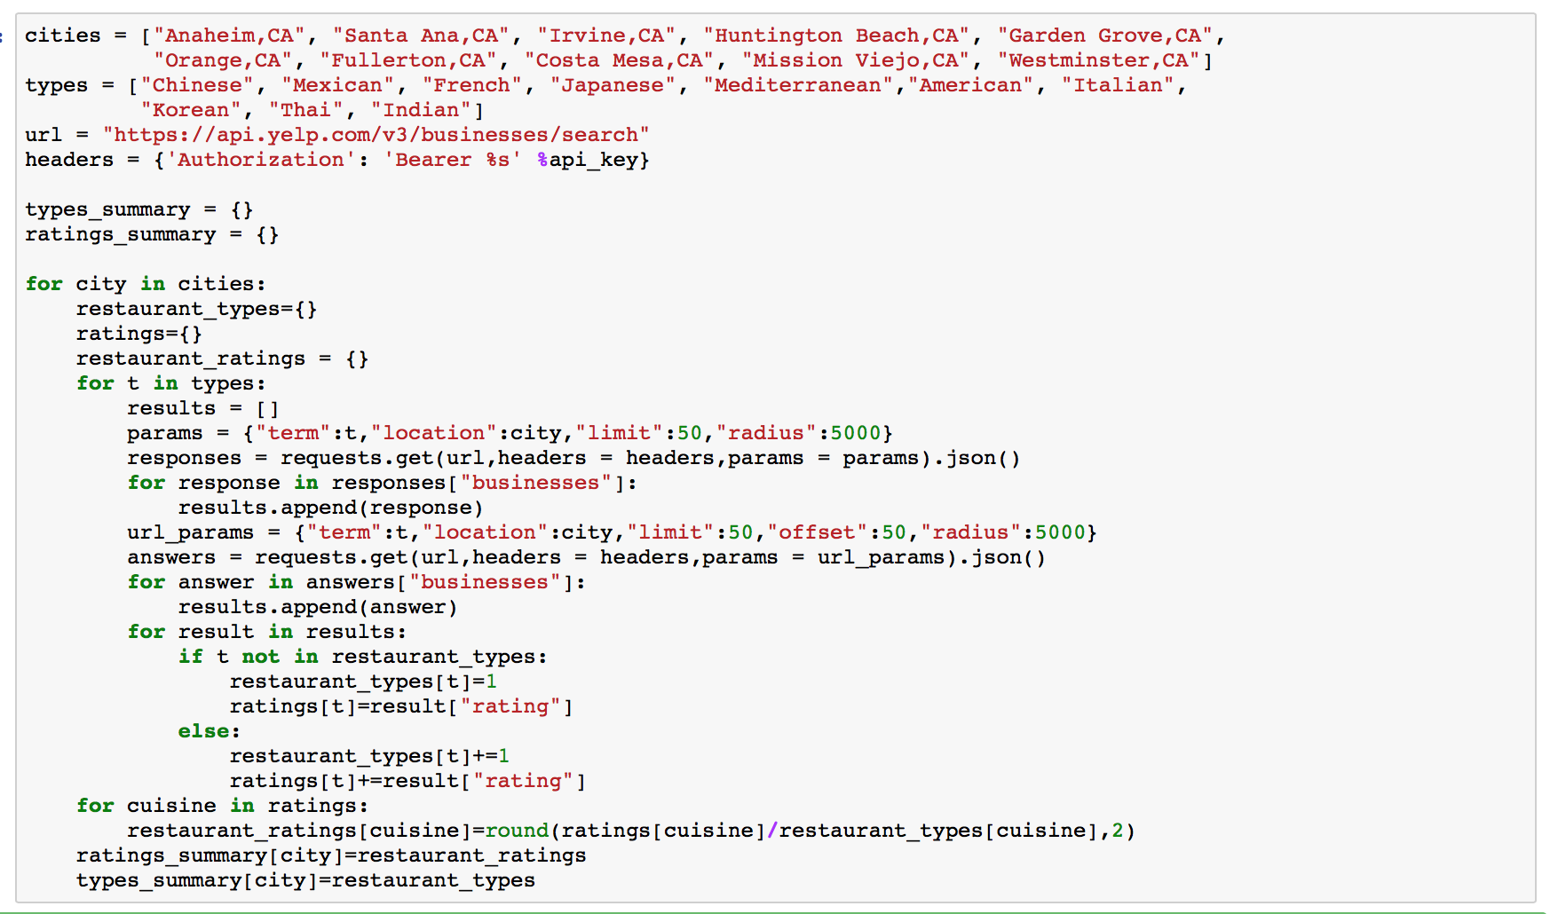
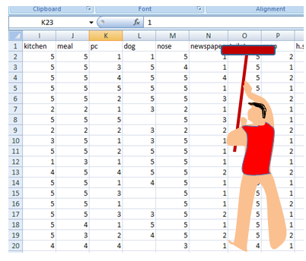
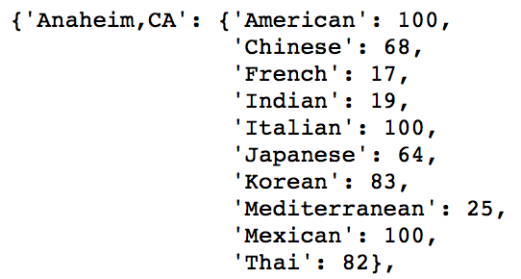
Data Cleaning

Slide 7
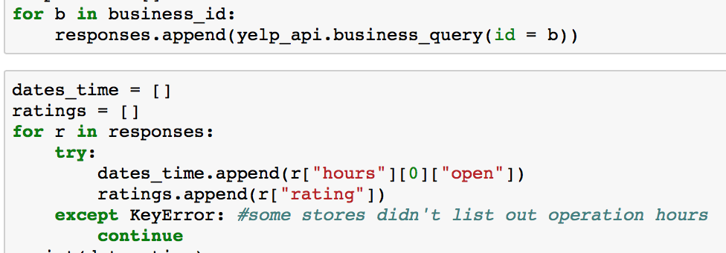
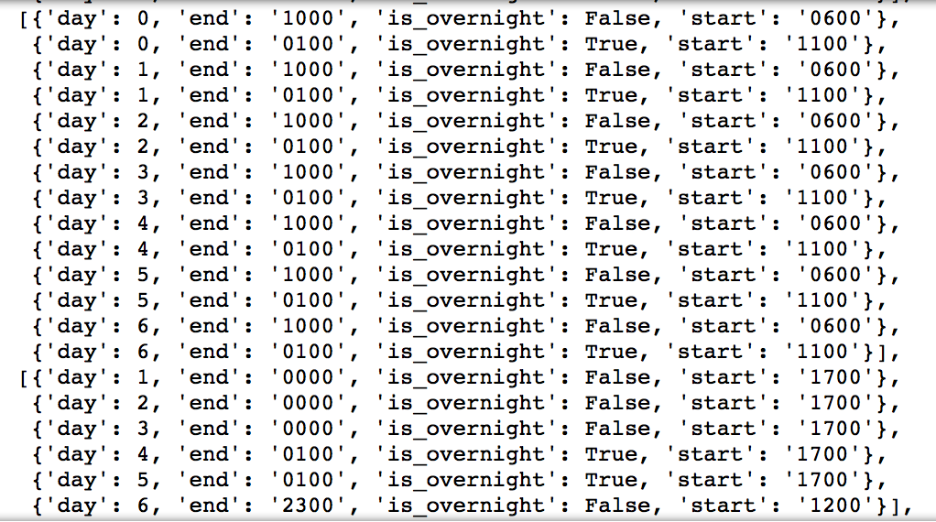
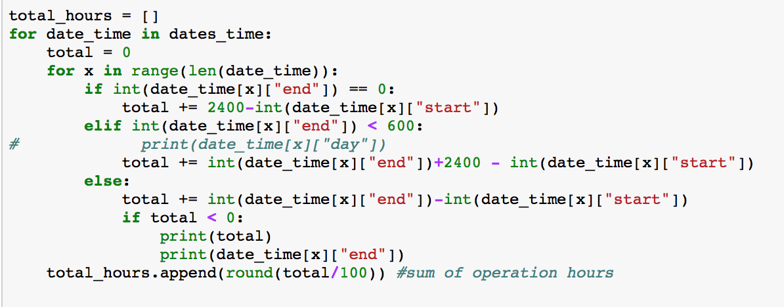


Slide 8
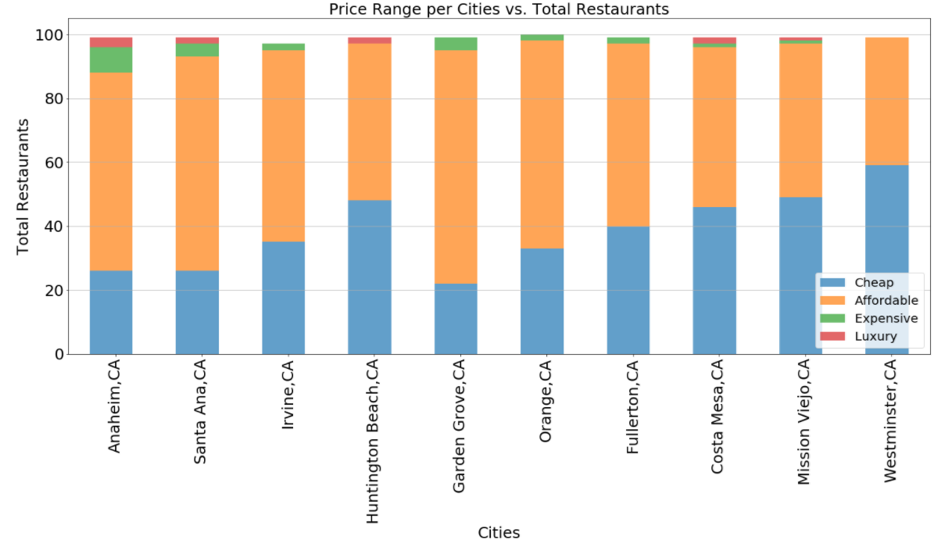
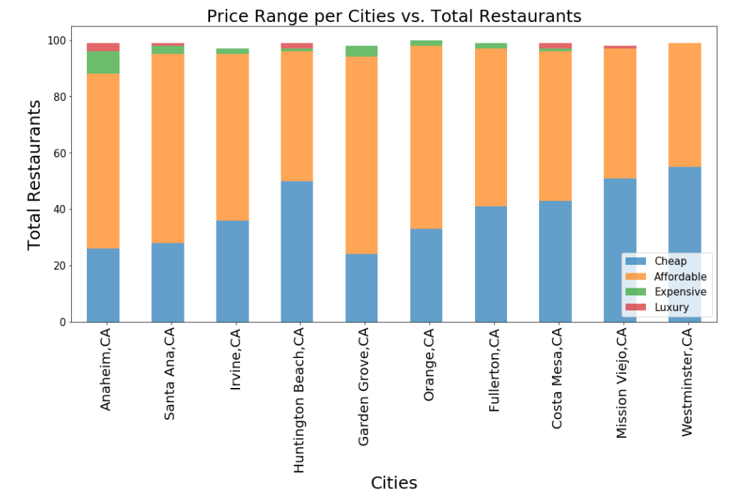
Notes:
From our dataset, we made a stacked bar graph to compare the total restaurants across each segmented bar, each bar representing a city. The segments in each bar are divided into smaller categories. They show the valuation the Yelp API uses, and we have translated them to “cheap” for $, “affordable” for $$, “expensive” for $$$, and “luxury” for $$$$. You can see that Westminster has the most number of cheap restaurants and Anaheim has the most number of luxury restaurants.

Slide 9
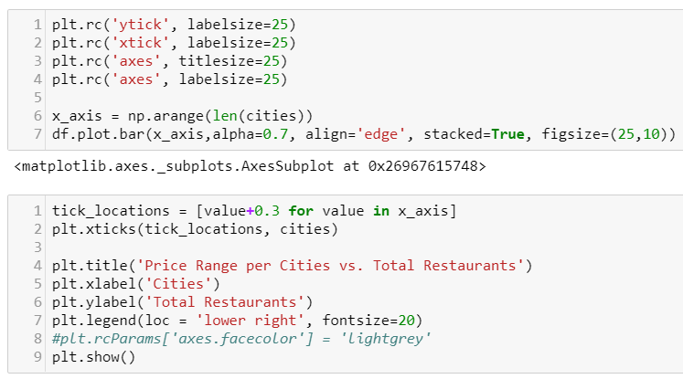
Code for stacked bar graph
Notes:
The code for the stacked bar graph is similar to that of a bar graph we learned in class. The main difference is the parameter containing “stacked = True”. We could also assign our own color schemes using the colors parameter if we wanted to, and also assign our own background color for the graph.

Slide 10
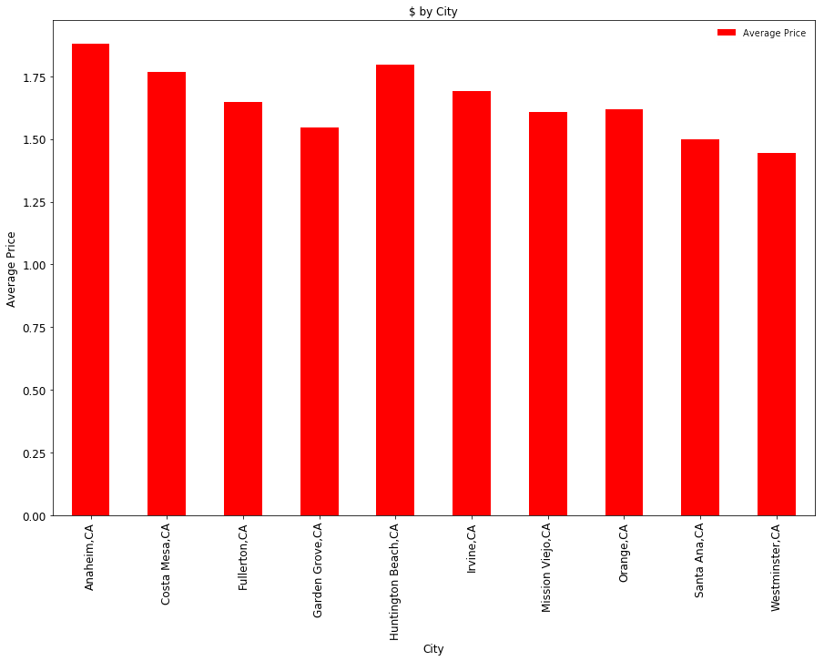
Average $ Per City
Notes:
Next, we have an average $ by cities chart. Using the dataframe, we calculated the average for the top 100 restaurants. How did we do this? We assigned weights to each category, based on price point, and then created an average by city, in order to assess which cities were more accomodating of higher price points. Our data returned the following: Anaheim has the largest $ average, followed by Huntington Beach, Costa Mesa, then Irvine. As you can see, Garden Grove has the lowest total average price point for popular restaurants.

Slide 11
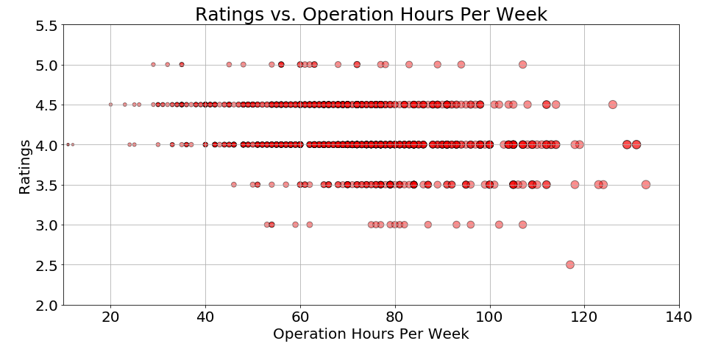
Notes:
From our dataset, we wanted to see if there was a relationship between restaurants’ ratings vs their total operation hours per week so we created a scatter-plot to visualize the data.

Slide 12
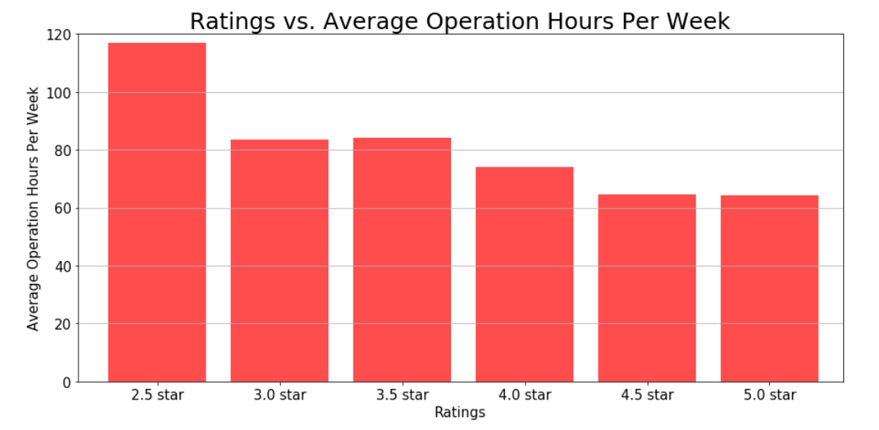
Notes:
Another way to visualize the relationship between the ratings and operation hours per week was using the bar graph. To create the bar graph, we had to calculate the averages for the operation hours per week. From these two data representations, we can see that the restaurants with longer average operation hours per week tend to have lower ratings. So think fast food restaurants like McDonalds or Burger Kings.

Slide 13
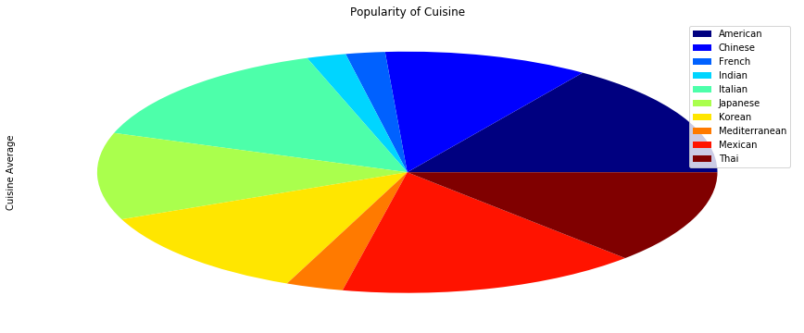
Average Rating by Cuisine
Notes:
Per our chart, most restaurant cuisines in the OC seem to be Mexican, followed closely by American, and Chinese. We determined the population density by the restaurants with the highest density in yelp reviews. Mexican food was the overall highest, with most cities topping our cap at 100 restaurants out of 1000. American was a close second at 98 out of 1000, same as Chinese.

Slide 14
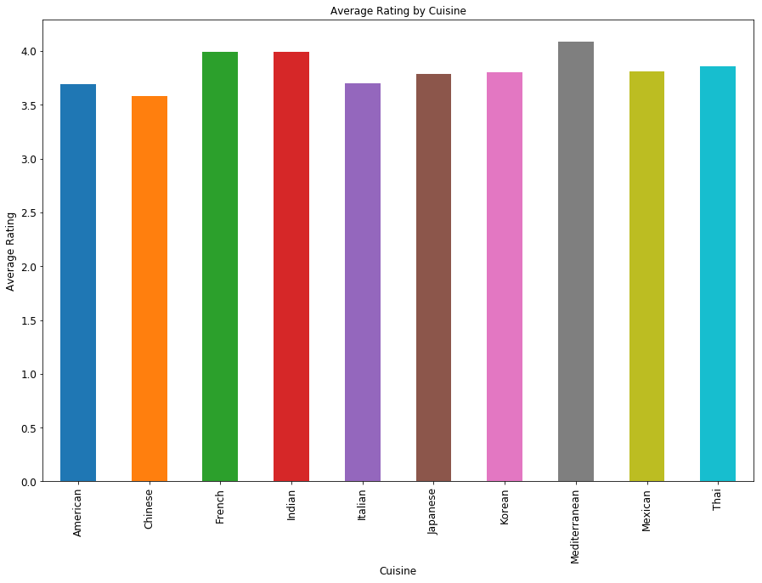
Average Rating by Cuisine
Notes:
Our most highly rated restaurants were Mediterranean, French, and Indian.

Slide 15
Data Analysis
1) Business question: Which city, of the chosen 10, has the highest price point for popular restaurants?
To analyze the data, we pulled the top 100 restaurants per each city. As we were limited by the yelp API to only 50 per search, we add two lists together. Then we pulled the price points for each rating and compared the two. Yelp has categorized its price points by dollar signs, so we used this categorization to determine which cities had what price point. We then averaged the data to determine the data of the 10 cities chosen. We found Anaheim, CA has the highest price point for its popular restaurants
2) Business question: How many hours of operation should you open your restaurant for?
To analyze the data, we used the restaurants from the 10 cities we pulled in the previous question, and then pulled the data for operation hours of the week. We summed the total of the hours per week and applied the sum to the restaurants. We then applied the yelp customer ratings to the restaurants and categorized the results based on yelp rating. We also found the average rating per sum of operation hours. We found that the highest rated restaurants by sum of hours and average, were open 100 hours or less.
3) Business question: What’s the most popular restaurant cuisine in these OC cities?
To analyze the data we again used the data from question 1 and also applied the customer ratings pulled from question 2. Our metric for popularity was the yelp customer ratings with the highest being 5 and lowest 1. We applied the data to each other, found the average rating of the restaurants based on type of cuisines, and applied the yelp metrics to deem popularity. We found the most popular restaurant cuisine based on reviews was Mediterranean.

Slide 16
Discussion
Thus after our different analyses, our recommendation to our client is that the best cuisine type to open based on popularity is Mediterranean. The hours of operation per week they should stay open to maximize the popularity of said ratings is 100 or less; and the city that offers the highest price per rating is Anaheim.
For the most part we found what we expected to find. We were surprised by how few expensive restaurants were in Irvine and Costa Mesa. We were also surprised to find cities like Newport Beach and Tustin did not have enough restaurants to make our list. We concluded that based on our cuisine choices and the scope of our restaurants being only the top 100 based on popularity, not all expensive restaurants and lower rated restaurants were included in our data set.
The general conclusions we can draw from our data set are that to maximize ratings, it is better to keep your restaurant open for less time. In addition, lower density of cuisine type could lead to higher average rating. Lastly, the most popular restaurants were on the cheaper side of the yelp rating scale.

Slide 17
Post Mortem
Choosing cities and cuisines - some cities did not have enough of cuisine type we had requested. We wanted to choose the 10 most populous cities, but some did not have enough restaurants based on the cuisine we chose.
There are 34 cities in Orange County, so we chose only 10 cities and their 100 most popular restaurants to limit the amount of data we would use. Yelp has a limit of only 50 restaurants per search so we chose the top 100 based on the limit.
We were interested in sorting the price points by zip code to break down even further to find exact locations but the numerous zip codes made this difficult so we switched to cities.
We would research the entirety of the County and add more restaurants to get more varied and in-depth results. Our results favored cuisines with less density and a more varied and fuller data set would have mitigated this discrepancy.

Slide 18

Q & A!

